Slide 1

UK Train Project

Slide 2

Team Members
1
Lilian Ezzat
2
Esraa Yasser
3
Israa Ahmed Helmy
4
Ahmed Gamal
5
Mostafa Hossam
6
Mohab Fekry

Slide 3

Project Overview
This project analyzes railway ticketing and journey data to understand passenger booking behavior, ticket sales, and train performance. It covers details such as purchase type, payment methods, ticket classes, prices, stations, journey times, and delays. The goal is to gain insights into customer preferences, revenue patterns, punctuality, and reasons for delays, while also exploring opportunities for improving efficiency, predicting demand, and enhancing the passenger experience.

Slide 4
Project Idea
Problem
Train passengers in the UK frequently face delays, cancellations, and inconsistent service quality.
These issues negatively impact passenger satisfaction and operational efficiency.
Without clear data insights, identifying root causes and performance patterns is challenging.
Solution
Developed an interactive Power BI dashboard analyzing 31,653 real-world train booking records.
Provides insights into ticket sales, peak travel times, delay patterns, refund trends, and passenger behavior.
Empowers decision-makers to improve service delivery and operational efficiency.
Unique Value
Transforms complex railway data into an intuitive, decision-focused dashboard.
Designed for both technical and non-technical users.
Addresses business pain points, reduces losses, and enhances customer satisfaction through evidence-based decisions.

Slide 5

Original Dataset
Source: Raw CSV dataset
Transaction ID
Price
Dates: Date of Purchase, Date of Journey as date
Times: Time of Purchase, Departure Time, Arrival Time, Actual Arrival Time as time
Categorical: Purchase Type, Payment Method, Railcard, Ticket Class, Ticket Type, Departure Station, Arrival Destination, Journey Status, Reason for Delay, Refund Request

Slide 6
Project Process
Cleaning
Modeling
Dax
Sample Visual
Report
Dashboard

Slide 7
Dashboard Skeleton
Landing Page
Ticket Analysis
What is the distribution of ticket types sold (e.g., Anytime, Off-Peak)?
Which ticket class generate the highest revenue?
What is the average ticket price per route or station?
How do ticket sales vary by time (day/week/month)?
What is the refund rate and its reasons?
Passenger Analysis
What are the demographics of passengers (age group, railcard usage)?
How many passengers travel with railyards vs. without?
What are the most common journey patterns by passenger type?
How does passenger volume change over time?
Which customer segments are growing or declining?
Station Analysis
Which stations have the highest passenger traffic?
What is the average delay per station?
Which stations have the most complaints?
What is the revenue generated per station?
Are there seasonal or time-based patterns in station usage?

Slide 8
Dashboard Skeleton
Complaint & Customer Satisfaction
What are the most frequent complaint categories?
Which stations or ticket types receive the most complaints?
What is the resolution rate of complaints?
How does customer satisfaction vary by journey type or station?
Are there trends in complaints over time?
Financial Analysis
What is the total revenue and cost breakdown?
Which ticket types or stations are most profitable?
What is the refund impact on revenue?
How does revenue trend over time?
What is the revenue per passenger or per journey?
Hero Station (e.g., Manchester Piccadilly)
What is the passenger volume and revenue for this station?
What are the top routes and ticket types used here?
What is the delay and complaint rate at this station?
How does this station compare to others in performance?
What are the satisfaction scores and feedback trends?

Slide 9
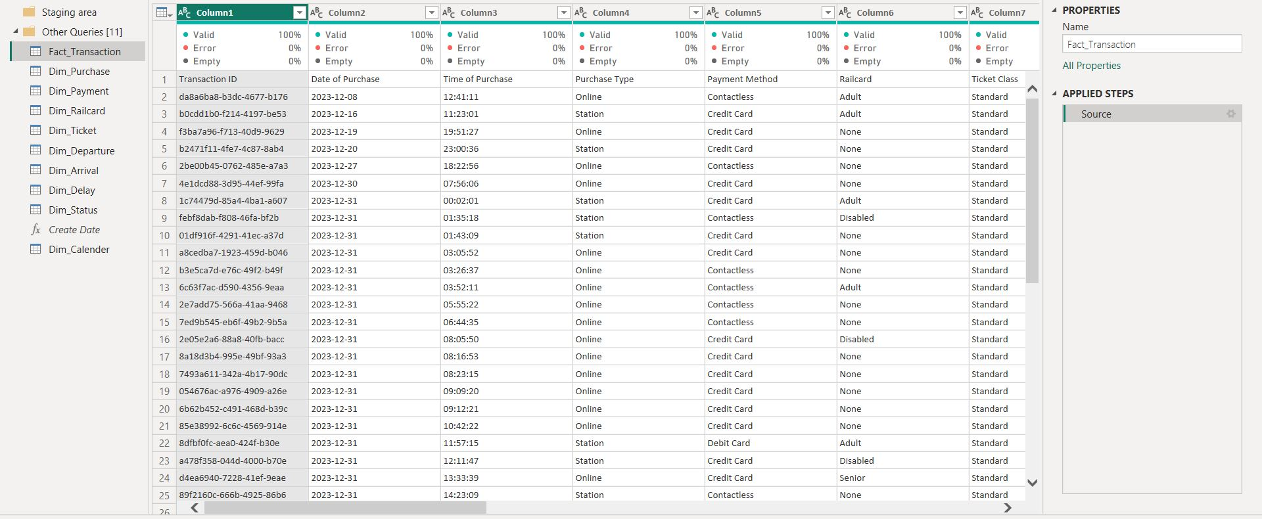
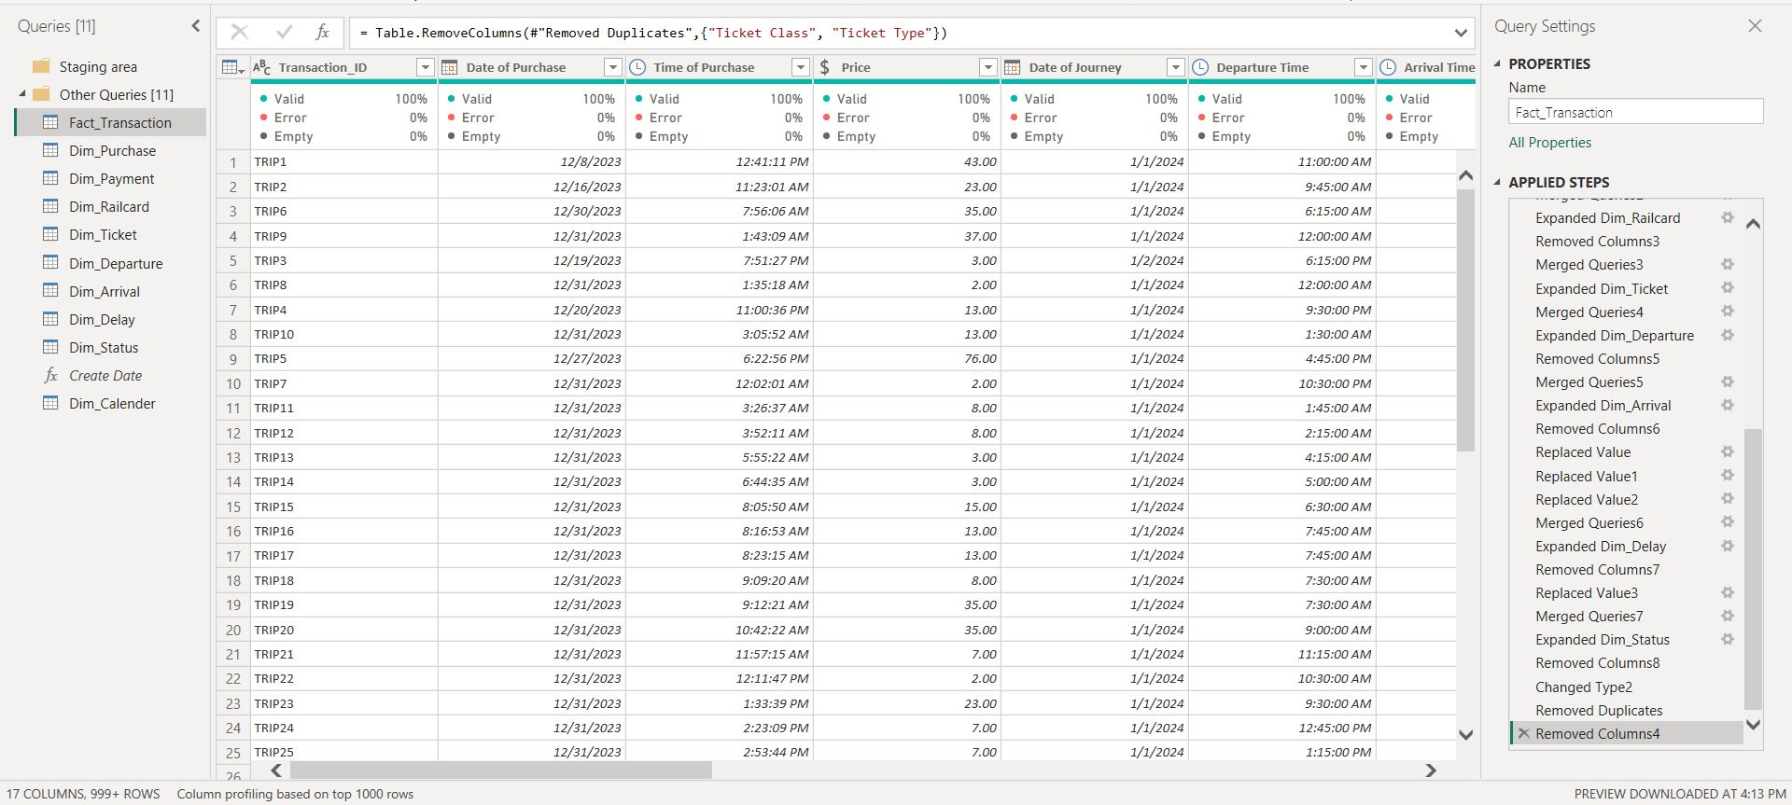
Cleaning
Before
After

Slide 10
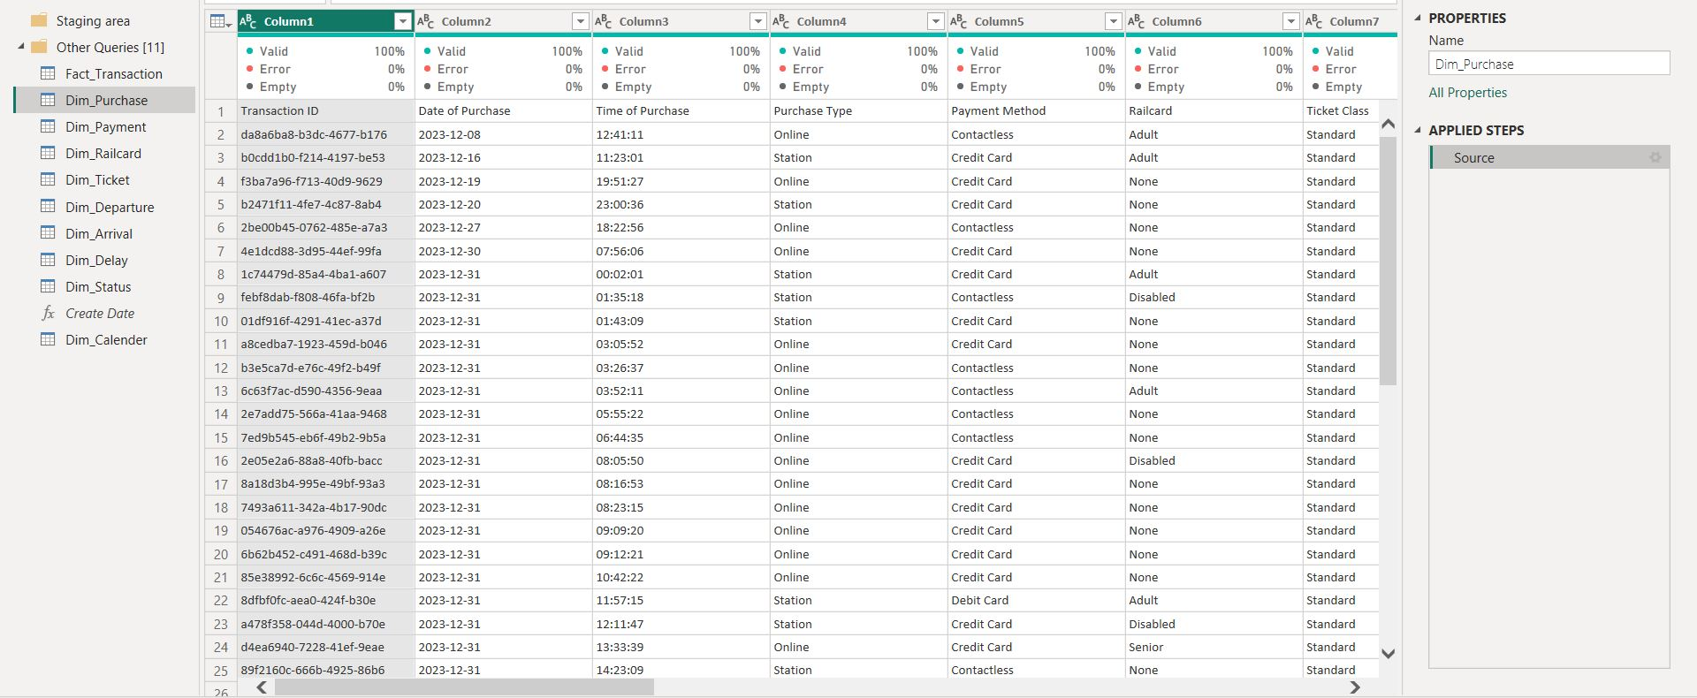
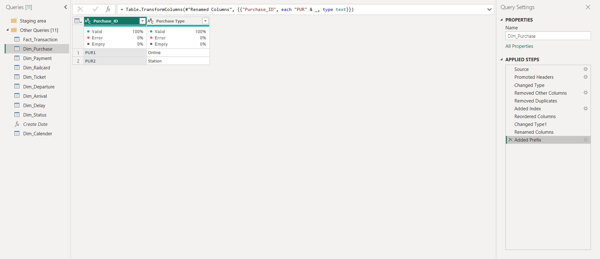
Cleaning
Before
After

Slide 11
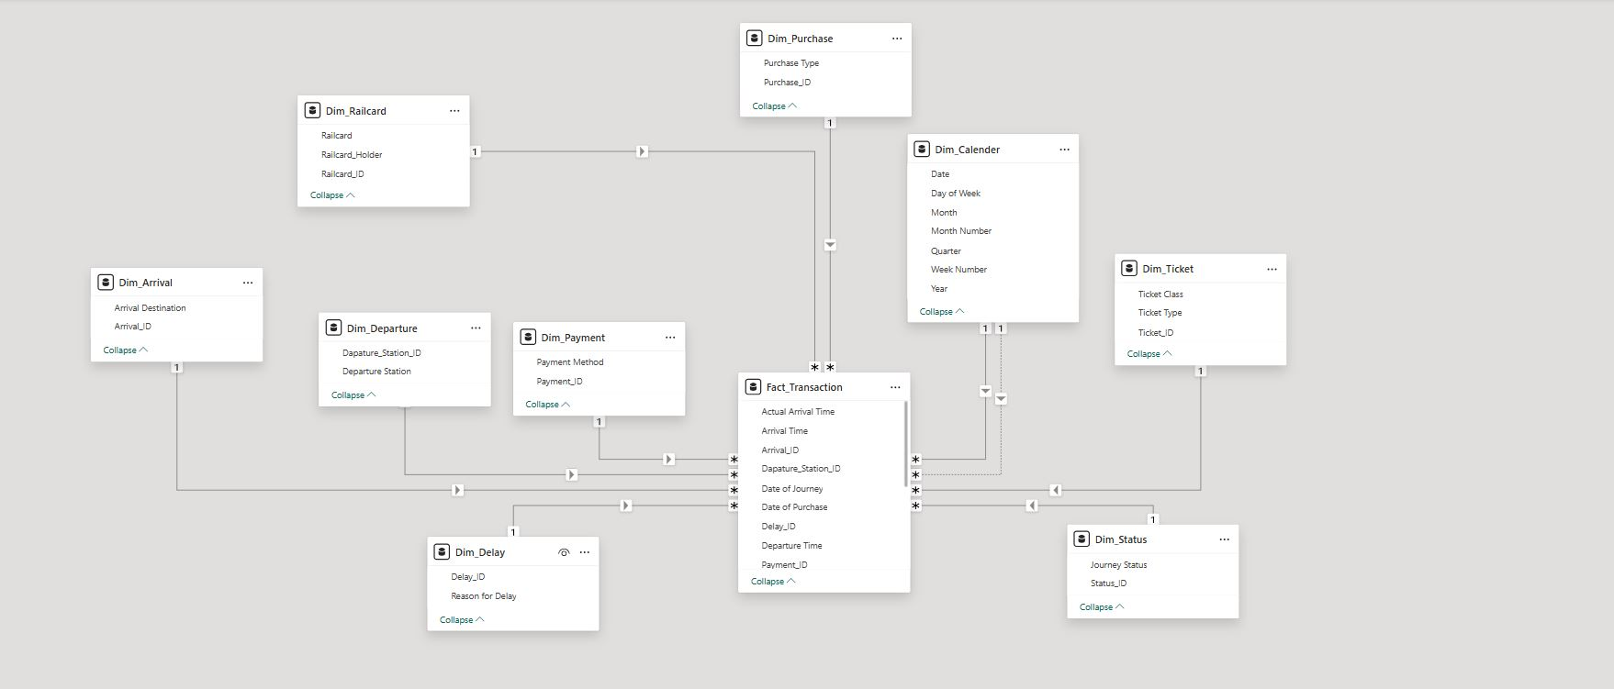
Modeling

Slide 12
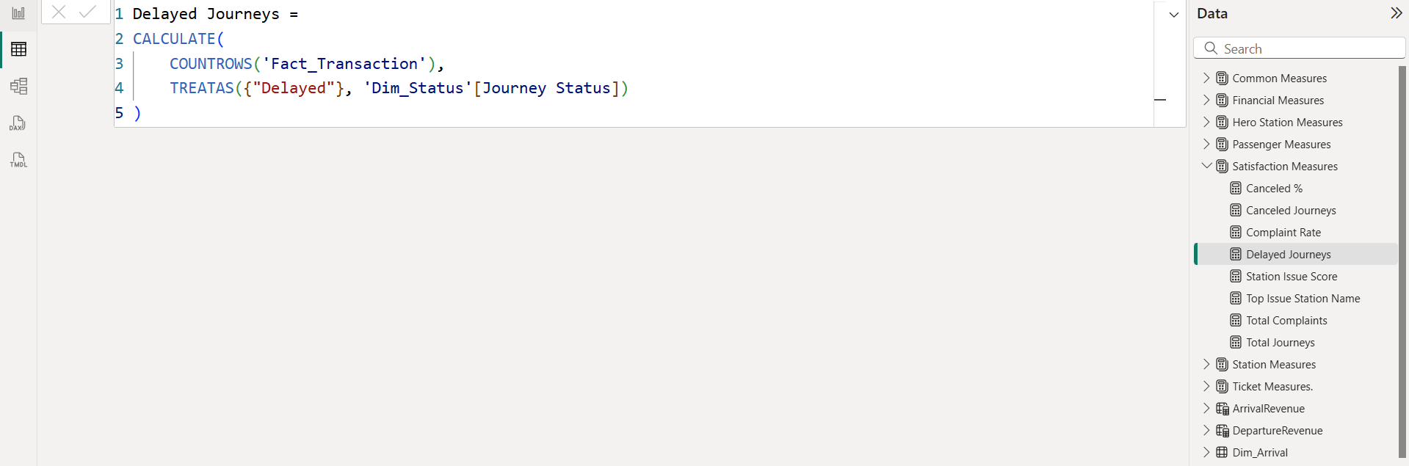
DAX

Slide 13
DAX & Measures
Total Tickets = COUNTROWS(Fact_Transaction)
Total Revenue = SUM(Fact_Transaction[Price])
Refunded Tickets = CALCULATE([Total Tickets], Fact_Transaction[Refund Request] = "Yes")
Refunded Revenue = CALCULATE(SUM(Fact_Transaction[Price]), Fact_Transaction[Refund Request] = "Yes")
Refund Requests = CALCULATE( COUNTROWS('Fact_Transaction’), 'Fact_Transaction'[Refund Request] = "Yes")
Refund Rate % = DIVIDE([Refunded Tickets], [Total Tickets], 0)
Net Revenue = [Total Revenue] - [Refunded Revenue]
% of Delayed Trips = DIVIDE([Complaints Count], [Passenger Count], 0)
Adult = CALCULATE(COUNT(Fact_Transaction[Railcard_ID]),Dim_Railcard[Railcard]="Adult")
Disabled = CALCULATE(COUNT(Fact_Transaction[Railcard_ID]),Dim_Railcard[Railcard]="Disabled")
Holder = CALCULATE(COUNT(Fact_Transaction[Railcard_ID]),Dim_Railcard[Railcard_Holder]="holder")
Non Holder = CALCULATE(COUNT(Fact_Transaction[Railcard_ID]),Dim_Railcard[Railcard_Holder]="non-holder")
Senior = CALCULATE(COUNT(Fact_Transaction[Railcard_ID]),Dim_Railcard[Railcard]="Senior")
Total cardholder = COUNT(Fact_Transaction[Railcard_ID])
Net Tickets Sold = [Total Tickets] - [Refunded Tickets]
Average Ticket Price = DIVIDE([Total Revenue], [Total Tickets])

Slide 14
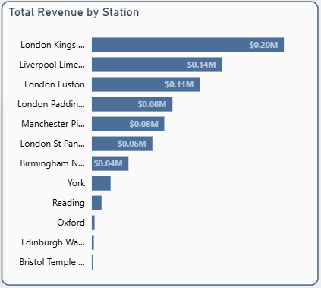
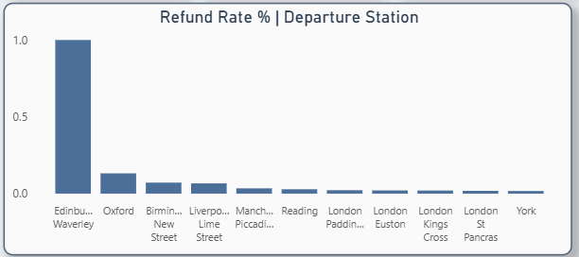
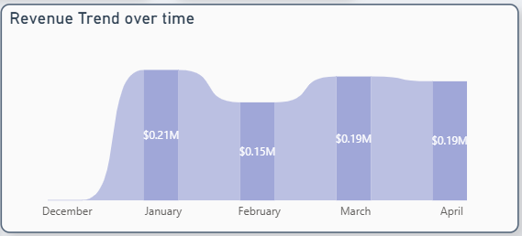
Visual Samples

Slide 15


